Slide 1
Preservation Audio Using METS:
The Sound Directions Project
Robin Wendler
r_wendler@harvard.edu
Harvard University Library
7 May 2007

Slide 2
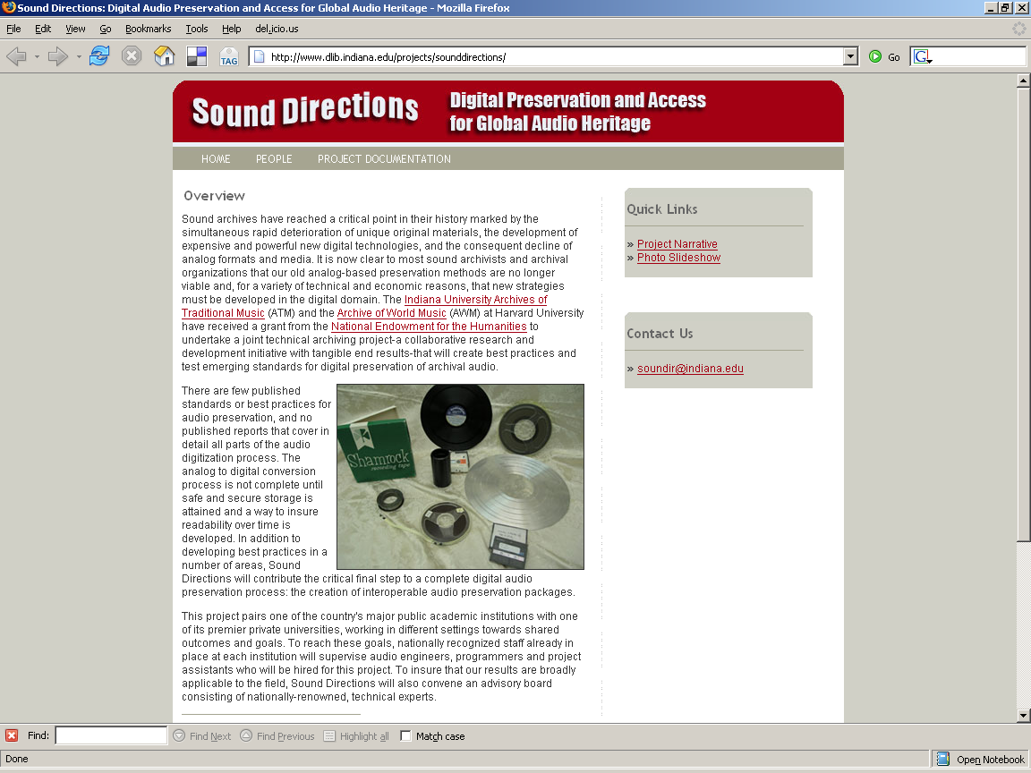
Goals
“Develop best practices and test emerging standards for archival audio preservation and storage in the digital domain”
Establish programs for digital audio preservation at each university that will enable us to continue this work into the future, and which will produce interoperable results
“Preserve critically endangered, highly valuable, unique field recordings of extraordinary… interest.”
Participants
  Indiana University
  (Archives of Traditional Music)
  Harvard University
  (Archive of World Music)
Notes:
The goals for this project were very ambitious, and some have been met and some have not. Both organizations now have programs for digital audio preservation, although IU’s preservation repository is still under development. Both institutions have preserved thousands of critically endangered, highly valuable, unique field recordings. And both have tested emerging standards for archival audio preservation. Development of best practices and interoperable results are not where we would like them to be.
Much of the rest of this presentation is really about that discrepancy between where we are and where we know we should be, and about why it’s so hard to get there.

Slide 3
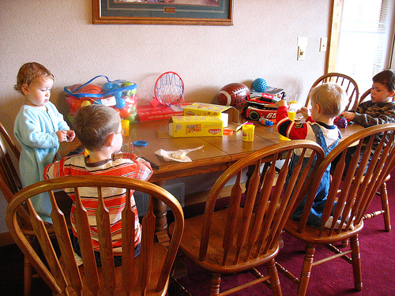
Parallel Play
Notes:
Any of you with children know that there is a developmental stage called parallel play, where children enjoy pursing similar activities in the same space, but they do not yet know how to cooperate and play together. That is about where digital archives are now

Slide 4
Context
Harvard
  7-year-old home-grown preservation repository
  METS profile created to meet internal needs
  Mixed PC/Mac-based audio studio
  Pyramix
Indiana
  No preservation repository now; Fedora implementation in process
  METS profile created for this project
  PC-based audio studio
  WaveLab
Notes:
Not only are Harvard’s and Indiana’s technical environments different, but Harvard has been archiving digital audio for several years. This means that Harvard implemented METS to meet its own internal requirements, and changing that would mean major redevelopment of tools and workflows plus large scale retrospective conversion of existing objects. Harvard’s audio METS design was influenced by a strong conviction that commercial tools and standards will be most supportable for rendering audio to end users and for subsequent re-engineering the objects as necessary. Thus Harvard’s METS is optimized for delivery back into commercial audio workstations, so that neither engineers nor users would interact directly with the METS. Indiana believes it will easier to write and maintain their own audio presentation tools for users, and they have experience with this in the Variations projects. However, they are in the early stages of implementing a preservation repository and have not done quite as much planning for how to present archival files back to an engineering workstation. So H and IU have come at this from very different perspectives

Slide 5
Sound Directions:
Scope of interoperation today
Preservation archiving and exchange only
  No end-user delivery required
  No descriptive metadata required
  Exchange → Ingest → Re-export
Notes:
Because of the enormous difference between the two universities’ practices, for this phase of the project the scope is quite narrow. We are leaving descriptive metadata and end-user delivery out of this phase. The libraries must show that they can exchange their digital audio objects, ingest each others, and re-export them intact to the original partner.

Slide 6
Standards Used in
Sound Directions
Audio file format
  AES31-2-2006 (Broadcast Wave)
Audio decision list
  AES31-3-1999
    under revision to include markers
Archival packaging
  METS
Technical metadata
  AES Audio Object (in draft)
Digital provenance metadata
  AES Process History (in draft)
Indiana using current version
Harvard using new draft
Notes:
It was very important to both universities to adopt open standards, and there are many areas in audio processing where standards come into play. Doing this has helped us even when our choices of which versions to use and which options to adopt within a standard have differed. Apart from METS, the key standards for this project come from the Audio Engineering Society (AES).
The audio file format is Broadcast Wave. The edit decision list is AES31-3. Indiana is using the current version, which does not include native support for markers. They put nuendo markers in an extension chunk. Harvard is using the new draft, which does include native marker support. Just this morning I learned that the proposal has been accepted to develop the new version in XML instead of as a text file, which will integrate better with METS and enable Unicode support, both of which are important steps forward.
Technical metadata for audio files and digital provenance metadata for each object are expressed using draft standards from AES.

Slide 7
Digital Audio Object = What?
Song?
Performance?
Capture Event?
Side/Track?
Physical Item?
For archival preservation,
we create one METS for each original piece of media.
This does not prevent presentations based on other structures.
Notes:
One of the earliest discussion centered on what kind of object was being modeled, that is, what would an archival object for preservation audio correspond to? There are many ways to model audio objects, but because of the archival nature of both collections, we easily agreed to create one METS per original piece of media. For rendering purposes, however, other presentations may be created, for example by using SMIL to deliver in a single presentation audio that is split across several separate METS objects.

Slide 8
METS Sections Used
M
E
T
S
Header
Descriptive
Metadata
Source Metadata
Administrative
Metadata
Technical
Metadata
File Section
Digital Provenance
Metadata
Structure Map
Notes:
Rights being documented and tracked by each participating institution, but are not covered in this exchange.

Slide 9

AUDIO VERSION
METADATA
Source media
techMD: Audio Object
Preservation master (in 1…n files)
techMD: Audio Object (1..n)
Audio Decision List (Harvard)
Preservation master intermediate (1..n)
techMD: Audio Object (1..n)
Audio Decision List (Indiana)
Production master (1..n)
techMD: Audio Object (1..n)
Audio Decision List
Deliverable(s) (1..n)
techMD: Audio Object (1..n)
SMIL (Harvard)
…Plus one digiprovMD for the entire project
Notes:
In the course of audio preservation, engineers will work with many different versions of the content. Metadata will be created and retained for all of them, but not all versions of the content will be kept.
There is always a source object, analog or digital, for which technical metadata will be created

Slide 10
Toolfest
Extensive set of small, modular tools and scripts
Add markers
Add pan entries
Add to process history
ADL dump
ADL fix
ADL info
ADL interleaver
ADL path substitution
ADL source
ADL to SMIL
ADL to XML
BWave concatenate
BWave cut
BWave edit
BWave info
Calculate checksum
Compare checksum
Convert markers
Convert SMIL
De-interleaver
Edit ADL header
Generate USID
Generate UUID
Get pan maps
Interleaver
JHOVE
Marker dump
Make MBIT+ditherer MD
Make RA producer metadata
Make resampler metadata
Make RmEditor metadata
Mirror project
Make RA tech metadata
Reverse audio
Time code dump
Time code/sample convert
Notes:
As far as the tools go, I’m just going to talk about Harvard. Most of them are not specific to Harvard’s infrastructure and could be reused in other environments. All will be made available as open source.

Slide 11
Now we’ve got all the parts.
How do we make a METS?
Populate directory on a file system
Run one tool (DMART) to construct an audio deposit package
  mets.xml
    Including
      Audio object technical metadata
      Process history metadata
      ADLs
    Referencing external files
      Archival master audio
      Production master audio
      Deliverable Real Audio
      SMIL
  a batch.xml file containing administrative metadata about the deposit.
Notes:
Copy all the content files and metadata files into a specified directory structure.

Slide 12
File Groups
M
E
T
S
Header
Harvard
<fileSec>
<fileGrp ID=“Wave”> … </>
<fileGrp ID=“Real”> … </>
<fileGrp ID=“AES31”>… </>
<fileGrp ID=“SMIL”> … </>
</fileSec>
Descriptive
Metadata
Administrative
Metadata
Indiana
<mets:fileSec>
<mets:fileGrp ID=“files-audio”>
<mets:fileGrp ID=files-audio-preservation”
USE=“PRESERVATION_MASTER “> … </>
<mets:fileGrp ID=files-audio-preservationInt”
USE=“PRESERVATION_MASTER_INTERMEDIATE”>…</>
<mets:fileGrp ID=files-audio-production2496”
USE=“PRODUCTION_MASTER”> … </>
</mets:fileGrp>
<mets:fileGrp ID=“files-aes31” USE=“ADL”> … </>
<mets:fileGrp ID=“files-doc” USE=“descMD”>… </>
<mets:/fileSec>
File Section
Structure Map
Notes:
So how are we using METS? I don’t have time to compare our use of all the sections, but suffice it to say that not one are we using exactly the same way. For us to interoperate, we must invest in changing our existing tools and processes or invest in conversion programs to change what we produce into a commonly-agreed upon form.
There are a few main points I’d like to bring out here.
Notice that Harvard is categorizing files by their format, while Indiana is categorizing them by their use. Both of these are legitimate approaches, and just serve to illustrate that there is no one right way to implement METS, even for one kind of digital object.
Both libraries felt the need to inventory here in the fileSec files that are function as metadata for the digital object. Today this is the only way to use the METS to convey checksum information to allow the receiving institution to check external files that are part of the exchange package for validity. The METS Board is looking into alternative approaches.

Slide 13
One structMap Approach
Indiana
M
E
T
S
Header
<mets:structMap TYPE="logical">
<mets:div TYPE="recording" LABEL="atm_99003">
<mets:div TYPE="face" LABEL="atm_99003_01">
<mets:div TYPE="section" LABEL="Section 1" ORDER="1">
<mets:fptr>
<mets:area
FILEID="file-atm_99003_010101_preservation"
BETYPE="TCF" BEGIN="00.00.00.00*0000"
END="00.13.25.03*2778" />
</mets:fptr>
<mets:fptr>
<mets:area FILEID="file-atm_99003_010101_preservationInt"
BETYPE="TCF" BEGIN="00.00.00.00*0000"
END="00.13.25.03*2778" />
</mets:fptr>
<mets:fptr>
<mets:area FILEID="file-atm_99003_01_production2496"
BETYPE="TCF" BEGIN="00.00.00.00*0000"
END="00.13.25.03*2778" />
</mets:fptr>
</mets:div>
Descriptive
Metadata
Administrative
Metadata
File Section
Structure Map
Notes:
Remember I said that Indiana plans to render the audio from the METS? For this reason, while they keep the ADL, they also convert it into a logical METS StructMap, listing the archival, production, and deliverable versions of the content for each segment.

Slide 14
Cross-fade splice
Indiana
M
E
T
S
Header
<mets:fptr>
<mets:par>
<mets:area
FILEID="file-atm_99003_010101_preservation"
ADMID="fade1" BETYPE="TCF"
BEGIN="00.27.51.15*0264"
END="00.27.51.15*2184" />
<mets:area
FILEID="file-atm_99003_010201_preservation"
ADMID="fade2" BETYPE="TCF"
BEGIN="00.00.35.13*0721"
END="00.00.35.13*2641" />
</mets:par>
</mets:fptr>
Descriptive
Metadata
Administrative
Metadata
File Section
Structure Map
Notes:
It is often necessary to splice audio files using a cross-fade technique. This can be expressed in a METS structMap using the <par> element to indicate that the two files should be rendered at the same time for the duration of the fade.

Slide 15
Alternative structMap
Harvard
M
E
T
S
Header
structMap TYPE="LOGICAL">
<div>
<div LABEL="archival">
<fptr FILEID="archival_2FAWM_5FDAT_5F172_5Fside_5F1.adl" />
<div LABEL="archival_2FAWM_5FDAT_5F172_5Fside_5F1Media">
<fptr FILEID="AWM_5FDAT_5F172_2Fside_5F1l.wav" />
…
<div LABEL="production">
<fptr FILEID="production_2FAWM_5FDAT_5F172_5Fside_5F1.adl" />
<div LABEL="production_2FAWM_5FDAT_5F172_5Fside_5F1Media">
<fptr FILEID="AWM_5FDAT_5F172_2Fside_5F1_.wav" />
…
<div LABEL="deliverable">
<div LABEL="deliverable_2Fsmil">
<fptr FILEID="AWM_5FDAT_5F172_2FDeliverable_2F.smil" />
</div>
<div LABEL="deliverable_2Fperformances">
<fptr FILEID="AWM_5FDAT_5F172_2Fdeliverable_2F1.rm" />
…
Descriptive
Metadata
Administrative
Metadata
File Section
Structure Map
Notes:
Harvard is not driving delivery off the METS, and the lead audio engineer believes that the ADL, being a standard native to the audio community, is a better choice for expressing the internal structure of the content, since audio workstations that will never understand METS will understand ADLs. For that reason, Harvard’s structMaps have never attempted to express the playlist, but invoke ADL and SMIL to support end-user delivery.

Slide 16
Different expectations drive different choices
Role of METS for audio
Navigation of content for end users
Navigation of content for audio engineers
Interaction of METS and audio standards
Should file references within AES metadata reflect METS internal structure or unpacked directory?

Slide 17



The way it works now
Harvard
Audio
METS
SIP
Indiana
Audio
METS
SIP
Harvard
Converts
For
Ingest
Indiana
Converts
For
Ingest
Harvard
Repository
Indiana
Repository
Notes:
At this point, the audio labs are generating digital objects and pass them both to it’s own repository and to the partner institution for conversion and ingest. The partner then archives the other’s object and can re-export it back to the originating institution. Proof of concept exchanges have taken place at this point, but not full scale exchange.

Slide 18
The way it should work
Harvard
Audio Object
Indiana
Audio Object
Harvard
Repository
Indiana
Repository
Convert to/from Common Profile
Convert to/from Common Profile
Common
Audio
METS
DIP/SIP
Notes:
The long term intention is that audio labs in each institution will feed digital objects into their respective repositories, and the repositories would produce OAIS DIP/SIP packages compliant with a common profile for exchange.

Slide 19
Sound Directions, 2005-2007
Funded by grant from National Endowment for the Humanities (U.S.)
http://www.dlib.indiana.edu/projects/sounddirections/index.shtml
Thank you!

Slide 20


Slide 21
Interaction of METS and audio standards
  References within AES metadata: should they be correct within archival package or correct once unpacked?
  In what applications/contexts will the content be used?
    End users
    Audio engineers

Slide 22
Things Harvard wishes it did differently
Don’t keep Mac Creator Codes.
  We plunk in boilerplate ones, not the ones that actually apply to files in the package. Don’t need any.
Don’t keep waveform files
  New technology generates them in under a minute vs. 40 minutes formerly.
Keep technical metadata for discarded intermediate content files as metadata, not as content. Don’t ask.

Slide 23
METS Element
Harvard
<mets xmlns="http://www.loc.gov/METS/" xmlns:xlink="http://www.w3.org/1999/xlink" xmlns:xsi="http://www.w3.org/2001/XMLSchema-instance" OBJID="AWM_DAT_172" LABEL="AWM_DAT_172" TYPE="AUDIO_SIP" PROFILE="Harvard" xsi:schemaLocation="http://www.loc.gov/METS/ http://www.loc.gov/standards/mets/mets.xsd">
Indiana
<mets:mets xmlns:mets=http://www.loc.gov/METS/ xmlns:xsi="http://www.w3.org/2001/XMLSchema-instance" xmlns:xlink=http://www.w3.org/1999/xlink xmlns:marc21=http://www.loc.gov/MARC21/slim xmlns:rights=http://cosimo.stanford.edu/sdr/metsrights/ xmlns:aes="http://www.aes.org/audioObject" xmlns:adlfade="http://www.dib.indiana.edu/xml/sounddirections/adlFade/" xmlns:ph="http://www.aes.org/processhistory"
xsi:schemaLocation="http://www.loc.gov/METS/://www.loc.gov/standards/mets/version15/mets.xsd http://www.loc.gov/MARC21/slim://www.loc.gov/standards/marcxml/schema/MARC21slim.xsd://cosimo.stanford.edu/sdr/metsrights/ http://www.loc.gov/standards/rights/METSRights.xsd://www.aes.org/audioObject http://www.dlib.indiana.edu/lib/xml/aes/audioObject.xsd://www.dib.indiana.edu/xml/sounddirections/adlFade/ http://www.dlib.indiana.edu/lib/xml/sounddirections/adlFade/adlFade.xsd://www.aes.org/processhistory http://www.dlib.indiana.edu/lib/xml/aes/processHistory.xsd"
ID="atm_66127_ot6584">

Slide 24
Header
Harvard
<metsHdr CREATEDATE="2007-02-09T15:58:34" RECORDSTATUS="PROD">
<agent ROLE="CREATOR" TYPE="OTHER" OTHERTYPE="DepositingAgent">
<name>Harvard College Eda Kuhn Loeb Music Library</name>
</agent>
</metsHdr>
Indiana
<mets:metsHdr CREATEDATE="2007-03-08T08:01:10">
<mets:agent ROLE="DISSEMINATOR">
<mets:name>Indiana University</mets:name>
</mets:agent>
</mets:metsHdr>

Slide 25
Descriptive Metadata
Harvard
[1] <dmdSec ID="DmdSec">
<mdWrap ID="dmd" MIMETYPE="text/xml" MDTYPE="MODS" LABEL="is part of collection">
<xmlData>
<mods xmlns="http://www.loc.gov/mods/v3" xmlns:xsi="http://www.w3.org/2001/XMLSchema-instance" xsi:schemaLocation="http://www.loc.gov/mods/v3 http://www.loc.gov/standards/mods/v3/mods-3-0.xsd" version="3.0"> …
Indiana
[1] <mets:dmdSec ID="atm_66127_ot6584-dmd-marc">
<mets:mdWrap MDTYPE="MARC">
<mets:xmlData>
<marc21:collection>…
[2] <mets:dmdSec ID="atm_66127_ot6584_01-dmd-index">
<mets:mdRef MDTYPE="OTHER" OTHERMDTYPE="atm_index" LOCTYPE="URL"
xlink:href="atm_66127_ot6584_01_production2496_20070126.doc"/>
</mets:dmdSec>

Slide 26
Source Metadata
Harvard
<sourceMD ID="original_2Fcoreaudio.xmlTechMD">
<mdWrap ID="original_2Fcoreaudio.xml" MIMETYPE="text/xml" MDTYPE="OTHER" OTHERMDTYPE="AESCoreAudio">
<xmlData>
<audioObject xmlns:xlink="http://www.w3.org/1999/xlink" xmlns:tcf="http://www.aes.org/tcf" xmlns:xsd="http://www.w3.org/2001/XMLSchema" xmlns="http://www.aes.org/audioObject" xmlns:xsi="http://www.w3.org/2001/XMLSchema-instance" xsi:schemaLocation="http://www.aes.org/audioObject http://hul.harvard.edu/ois/xml/xsd/drs/audioObject.xsd" ID="_11683680708410.3702112802312034" title="BACA Folk Arts '96 Week 5: Indo-Caribbean and African at Brooklyn Children's Museum" analogDigitalFlag="PHYS_DIGITAL" disposition="Returned to Loeb Music Library" schemaVersion="1.03b" xsi:type="audioObjectType">
Indiana
<mets:sourceMD ID="atm_66127_ot6584-source">
<mets:mdWrap MDTYPE="OTHER" OTHERMDTYPE="AESCoreAudio">
<mets:xmlData>
<aes:audioObject ID="atm_66127_ot6584-ao" title="Belgian Congo and Ruanda-Urundi, 1951-1952."

Slide 27
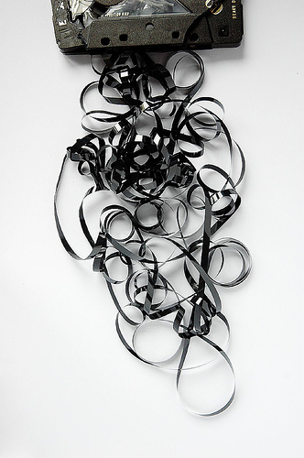
Audio on deteriorating media
  Analog and digital
Analog formats in decline
  Recording devices
  Players
  Replacement media
© Simon Bierwald. http://www.flickr.com/photos/indeed/75622824/
Notes:
For many years the audio preservation community did not accept digital reformatting, due to fears about quality and persistence. Three factors changed that:

Slide 28
Technical Metadata
Harvard
<amdSec ID="AmdSec">
<techMD ID="archival_2FAWM_5FDAT_5F172_5Farchival_5Fside_5F1_5FMedia_2FAWM_5FDAT_5F172_5FAM_5F01_5F01_5F_7B52A7EEB3_2D1ED4_2D4FA3_2D8385_2DC008F6F047F5_7D.xmlTechMD">
<mdWrap ID="archival_2FAWM_5FDAT_5F172_5Farchival_5Fside_5F1_5FMedia_2FAWM_5FDAT_5F172_5FAM_5F01_5F01_5F_7B52A7EEB3_2D1ED4_2D4FA3_2D8385_2DC008F6F047F5_7D.xml" MIMETYPE="text/xml" MDTYPE="OTHER" OTHERMDTYPE="AESCoreAudio">
<xmlData>
<audioObject xmlns:xlink="http://www.w3.org/1999/xlink" xmlns:tcf="http://www.aes.org/tcf" xmlns:xsd="http://www.w3.org/2001/XMLSchema" xmlns="http://www.aes.org/audioObject" xmlns:xsi="http://www.w3.org/2001/XMLSchema-instance" xsi:schemaLocation="http://www.aes.org/audioObject http://hul.harvard.edu/ois/xml/xsd/drs/audioObject.xsd" ID="_11704511308900.11208489734956295" title="BACA Folk Arts 1996 Week 5: Indo-Caribbean and African at Brooklyn Childrens Museum" analogDigitalFlag="FILE_DIGITAL" disposition="Deposited into DRS" schemaVersion="1.03b" xsi:type="audioObjectType">
Indiana
<mets:amdSec ID="atm_66127_ot6584-amd">
<mets:techMD ID="atm_66127_ot6584_010101_preservation-aesCoreAudio">
<mets:mdWrap MDTYPE="OTHER" OTHERMDTYPE="AESCoreAudio">
<mets:xmlData>
<aes:audioObject ID="atm_66127_ot6584_010101_preservation-ao"

